Slide 1
Better Together Champions
Joining together to Reduce Social Isolation Among Seniors in Nanaimo
Better Together: Age-Friendly Nanaimo

Slide 2
Welcome!
Notes:
Please introduce yourself and share one reason you are here today.

Slide 3
Agenda:
About Seniors Connect & The Champions Program
Health risks and signs of social isolation
How to identify seniors who may be at risk
Determine when and who to contact for assistance
Wrap up and Top 10
Certificates
Feedback/Evaluation
Better Together: Age-Friendly Nanaimo
Notes:
Top 10 Q&A ‘test of your knowledge’, and wrap up
Become a certified Better Together Champion ☺
1.5 Hours
Lots of opportunity for discussion and please ask questions throughout as well.

Slide 4
About Nanaimo Seniors Connect
Funded in part by the Government of Canada New Horizons for Seniors Program;
3-year collective impact project
Goal: Reducing the social isolation of seniors
Better Together: Age-Friendly Nanaimo
Notes:
One of nine similar projects across Canada; template will be used for future programs
New Horizons for Seniors Program are programs that enable seniors to share their knowledge, skills and experiences with others, and help communities increase their capacity to address local issues
Project began in May 2016; We are moving in to year 2 of 3 years – Sustainability is key to success – our partners AND working w/ other organizations
A framework to tackle deeply entrenched and complex social problems;
An innovative, structured approach to making collaboration work across government, business, philanthropy, non-profit organisations and citizens;
Aims to achieve significant and lasting social change.

Slide 5
Why is This Program Important?
Nanaimo as an example:
Seniors aged 55 and older in Nanaimo - 32,185 or 37.4% of the total population (2014).
60% of seniors 65+ (8,302) were living with low income
Phone Survey: 38% socially isolated
A growing issue around the world
Better Together: Age-Friendly Nanaimo
Notes:
So Why is this program important for Nanaimo??
Nanaimo comprises a high proportion of adults 55 years and over (Nanaimo is 37.4% compared to 31% for BC overall).
Nanaimo is growing – with the population increasing by 32.5% between 2004 and 2014 (compared to 11.5% growth for BC overall in the same period).
60% of seniors 65+ (8,302) were living with low income
Randomized Telephone Survey - Between September 26th and December 8th 2016, 800 randomly selected Nanaimo residents over the age of 55 were surveyed by telephone. Data gathered were statistically weighted by age, gender and region. Ability to generalize findings is limited because only land lines were called. Two distinct age groups of seniors emerged from the data: individuals between the ages of 55 and 59 and those over the age of 70.
Results indicated that 38% of survey participants were socially isolated.
Of this group, 30% did not have someone they could count on to listen when they needed to talk.
45% did not have someone to give advice in a crisis.
63% were not participating in activities as often as they would wish.
Other barriers: Lack of information, low self-esteem, widowed, caregiving, shrinking social network, feeling of not belonging

Slide 6
Better Together Champions Are…
The eyes and ears in the community
Focus on prevention
Businesses, community groups, social agencies, neighbours… anyone who cares about the well-being of seniors!
Better Together: Age-Friendly Nanaimo
Notes:
The BTC is Modelled after a program called Senior Connect developed by the Calgary Senior’s Resource Society which was developed after a tragic accident where a senior passed away in his home and was not discovered for 3 months. Despite signs of newspapers and mail piling up, and debris in his yard, no one investigated his whereabouts or knew who to call or what to do.
Who can be a Champion? Anyone! It’s the idea of a friendly face in the community who is looking out for the well-being of seniors…
More Examples of Champions: Seniors groups, youth groups, mail or newspaper carriers, tellers/bank personnel, apartment managers or staff, meter readers, office workers, repair personnel – Shaw, plumbers, etc.,
parks and recreation, Cashiers/delivery people/retail businesses, Pharmacy staff and delivery service staff
Fire, ambulance, police, Landscaping, cleaning, housekeeping staff, Ministers and laypersons within the various church communities

Slide 7
Social Isolation is:
Fewer relationships than we need to feel connected
Less contact with others than we need
Contacts/relationships are not mutually satisfying
The “new smoking” with regards to impact on health
All of these are very individual
Better Together: Age-Friendly Nanaimo
Notes:
Social isolation is defined as a low quantity and quality of contact with others, and an absence of mutually-rewarding relationships. It’s not a normal part of aging.
Not having someone to confide in
Not having help when needed
Not feeling valued
Not participating in as much activity as you want
Loss of confidence, low self esteem
Equivalent of smoking 15 cigarettes a day – evidence-based research
This all being said, there are people who are okay with being by themselves. We respect each individual’s right to choose a particular lifestyle.

Slide 8
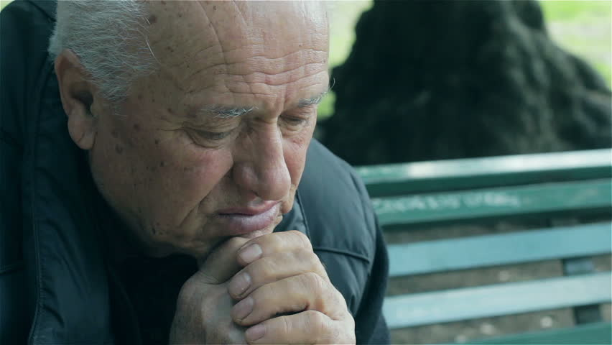
Health Consequences of Social Isolation
Increased chance of premature death
Reduced sense of well-being
Poor mental health
More depression
More disability from chronic diseases
Increased use of health & support services
Reduced quality of life
Caregiver burden
Notes:
Did you know that social isolation is the ‘new smoking’ with respect to negative impact on health?
Recent research confirms that individuals with adequate social relationships have a 50% greater likelihood of survival compared to those with poor or insufficient social relationships.
The magnitude of this effect is comparable with quitting smoking, and it exceeds many other well-known risk factors for mortality (e.g., obesity, physical inactivity).

Slide 9
Who Can Become Social Isolated?
Anyone!!
Better Together: Age-Friendly Nanaimo
Notes:
Social isolation can result from major events or from a combination of small events – we’ll talk more about that next!
How much these incidents affect people depends on the economic, personal, material and social resources that they have available to help them cope.
Seniors can draw on their life experience in managing difficult times to help them with the challenges of aging.
However, too many changes, especially one after another, can make it difficult to cope
How can this happen quickly, to someone who had a good quality of life. What changes can cause this?

Slide 10
Why are some seniors at risk?
Living alone
Being age 80 or older
Having poor/chronic health issues
Having no children
Lack of family contact
Lacking access to transportation
Living with low income
Changing family structures
Location of residence
Critical life transitions
Being a caregiver
Lacking awareness or access to community services & programs
Being Aboriginal or an immigrant
Better Together: Age-Friendly Nanaimo
Notes:
3 U’s:
Unaware they need help – What do you think might cause a senior to be unaware?
Depression memory loss or dementia – are not aware that they need help or severity
Some seniors believe declining mental and physical health are a normal part of aging and don’t get help when they really need it.
Seniors facing a problem may not be aware of the programs and services available to them
Language/culture barriers may also prevent from accessing services
Unable to get help - What do you think might cause a senior to be unable?
May know they need help, but don’t know who to call, or how to contact the appropriate services
Feel they can’t afford the services
Limited mobility + lack of transportation
Few friends or family to assist
Unwilling to get help - What do you think might cause a senior to unwilling to receive or get help?
Feelings of pride/self-reliance – don’t want to be a burden to others
Afraid of losing control over their lives
Fear of being forced to move to care facility
Sense of shame to seek help
Suspicion of social services or mental health
Limited financial assets
Not every senior will need help, but as a Champion, it’s important to know some of the risks that seniors face and be prepared to take action if necessary.
The protective factors for social isolation are the flip side of the risks:
Being in good physical and mental health;
Having enough income and safe housing;
Feeling safe in your neighbourhood;
Having communication and literacy skills
Able to find and get needed services;
Having satisfying relationships;
Having a supportive social network;
Feeling connected to and valued by others;
Having access to health and community services;
Feeling beneficial to society;
Having access to transportation;
Having a higher level of education.

Slide 11
Avoiding Social Isolation
Risk factors can be reduced:
Build and keep social connections
Know what social/financial/recreational resources are available
Seek support for life changes
Plan ahead for potential future changes as much as possible
Develop varied interests
Notes:
Build social connections—
family, friends, neighbours- take initiative.
Join things
Volunteer
Telephone friends/internet connection (skills)
Seek support around critical events—widowhood, caregiving, chronic illness, getting around/transportation
Plan ahead for potential future changes – Play “What if?”
Is your housing suitable—location, stairs, access to transportation
Driving
Develop varied interests
Meaning/satisfaction/pleasure—what are current sources?
Potential adaptations– substitutes—e.g., reading for aufio books
Think about how you cope with stress today
Physical exercise—How can you substitutive activities if need arises?
Did you know BC Transit offers free advice and sessions on how to ride the bus?
Mobility, incontinence, hearing/vision testing, use adaptive devices, address other health concerns.
Find something that genuinely interests you.
Volunteering – sense of purpose – what is meaningful and interesting to you?
Contact Seniors Connect offers
Free regular friendly phone calls and referrals to upcoming events, classes and more.
Take free computer lessons – can help to keep connected via Skype, Facebook, etc.

Slide 12
What to Look For
Physical Appearance
Clothing, grooming, untreated wounds, self-neglect, hygiene
Physical Challenges
Hearing, vision, mobility, incontinence
Mental and Emotional State
Confusion, personality changes, depression
Caregiver Stress
Feeling overwhelmed or trapped, unwilling to get help
Better Together: Age-Friendly Nanaimo
Notes:
Physical Appearance: These may be a first signs you will notice:
Inappropriate clothing for the weather
Changes to grooming – well-groomed senior appears dirty or disheveled
Significant weight gain or loss
Pale or flushed skin
Odors of urine or feces
Untreated wounds or bruises
Physical Losses:
Loss of: Mobility/ability to get around
Vision
Hearing
Ability to speak
Weight
Bladder control
Chronic illness
Mental and Emotional State: Can be caused by many things: Loss of partner, close friend. May lead to harmful situations if not dealt with
Signs:
Confusion or memory loss – may not remember they have met you several times for example
Lack of awareness where they are
Getting lost easily
Forgetting routine things such as day, month or season.
Drastic personality changes (i.e.; quiet shy senior becomes aggressive)
Inappropriate, hostile or repetitive responses
Seems sad or depressed
Increased nervousness, anxiety or suspicion of people
Persistent irrational beliefs
Seeing or hearing things that are not there
Forgets instructions or cannot make sense of them
Complains of not eating or difficulty sleeping
Caregiver Stress
Many people are finding themselves taking care of aging parents while still caring for a family at home. Some seniors will find themselves taking care of a spouse or disabled adult child – this can be very stressful and may result in stress and burnout for the caregiver.
Warning Signs include:
Caregiver complains of feeling overwhelmed or trapped. Wants it all to ‘end’.
Caregiver conveys the message that a loved one’s condition is getting worse despite his or her efforts.
Increasingly impatient or irritable
Seen to have no help/unwilling to get help
Alcohol or substance abuse

Slide 13
What to Look For
Social Withdrawal: ‘Disappear’ from social gathering
Financial Problems: Unpaid bills, utilities shut off, lack of food or medication
Home Condition: Poor repair/safety, unkempt yard, papers piled up, curtains always drawn
Focus on patterns of behaviour rather
than isolated incidents
Better Together: Age-Friendly Nanaimo
Notes:
Social Withdrawal - Can affect a senior’s ability to get food and other basic needs
Watch for seniors who:
Become withdrawn
‘Disappear’ from social gatherings or meetings
Express their loneliness
Are homebound and appear to have no family or friends
Financial Problems:
Many seniors live on a limited income, or are experiencing confusion about the state of their finances.
Signs include:
Unpaid bills
Little or no food
Can’t afford medications or necessities
Power, gas or phone service is cut off
Bank account is empty
Elder abuse is another topic all together
Example: A neighbour had been assisting an 86 year old senior living alone in her home getting groceries and to medical appointments. She noticed in her home a letter from a mortgage company saying that her home was going to be repossessed in 5 days if no payments were made. Senior was referred to outreach worker who noticed she was confused and didn’t understand the severity of this letter. Social Worker helped by contacting family from out of town who helped in organizing her financial affairs, family helped with payments moving forward.
Conditions of the Home - outside Signs may include:
Home in poor repair/structural safety issues
Unkempt or cluttered lawn
Newspapers piling up, mail piling up
Curtains always closed
Inside:
Fire hazards/overloaded outlets, careless smoking, stove left on, electrical shorts
Excessive garbage or clutter
Strong odors
Pets appear neglected
Elder Abuse:
Signs include:
Unexplained injuries, broken bones, sores or rashes
Changes in personal care/daily routine
Anxious, depressed or withdrawn
Expressed fear such as avoiding eye contact with a caregiver
Malnutrition, confusion or sedation
Funds not consistent with income
Can’t afford items they once were able to
Try not to jump to conclusions, simply observe and report your concerns to the help line

Slide 14
Taking Action – Connect!
Be aware of seniors in your sphere
Be approachable; acknowledge seniors - a smile & hello
Take a moment to chat
Get to know the seniors you see often – observe changes
Offer to take a senior grocery shopping, out for a coffee, offer assistance around the home
Check in by phone, email, visits
Better Together: Age-Friendly Nanaimo
Notes:
Being conscious of seniors leads to being aware of their usual presentation/behaviour so changes are then noticed
Someone who comes in a lot may have no where else to go
Creating a friendly, inclusive environment for all is positive for all, good customer relations

Slide 15
Taking Action–Refer (Emergency/At-Risk)
Call 911 in an emergency situation
Safety First: Ask a family member or friend for help!
You have identified a possible problem, now what?
BC211.ca – Now available province wide (24/7)
Call your local crisis line
You can remain anonymous
Better Together: Age-Friendly Nanaimo
Notes:
- Focus on patterns of behaviour rather than isolated incidents. BUT if you see something that you aren’t sure about, just call!
Crisis Line:
You will be asked to provide the information that you know about a situation, but it is not essential that you have all details to call.
You will be asked about the general health safety and appearance of the senior to determine if emergency services are needed.
Provide identification information as you can:
- Senior’s name, address (or directions to the home), phone number if known, approx. age,
- Details on why you are concerned
- You can always remain anonymous.
The information you provide to VICL will be used to determine the situation – and direct the senior to appropriate resources and supports. If urgent – emergency, police or other will be called
Follow-up is made depending on the expressed urgency of the situation.
The response may include a follow-up phone call, home visit, referral to appropriate services.

Slide 16
Ethical & Legal Considerations
Your name is not shared with the senior
Good Samaritan Act
Crisis Lines/BC 211 comply with privacy legislation and the Health Information Act
Better Together: Age-Friendly Nanaimo
Notes:
Confidentiality for the Champion - Very important to the program:
If you call the VI Crisis Line, your name will not be shared with the senior you are calling about even is he/she asks who called on their behalf
Champions can always can remain anonymous if you chose
All information regarding the referral services for the senior is completely confidential
Good Samaritan Act: The Champion who acts in good faith will not be held legally responsible for being concerned enough to make a referral.
VICL complies with all privacy legislation including PIPA (Personal Information Protection Act) and the Health Information Act In compliance
Ethical considerations:
We respect each individual’s right to choose a particular lifestyle
Ultimately, seniors would be informed of alternatives and options that will preserve their independence and enhance quality of life, but would not violate the senior’s right to privacy, or the right to NOT seek help or assistance (this would apply if/when they are able to contact and assess the senior. However, if there is big safety concern –they would refer to Mental Health Crisis Team or Police without the person’s consent. Also if the person seemed cognitively impaired and unable to make decisions- this is acceptable under law related to vulnerable persons. They would consult with the MH/Crisis response team who would then make the decision to pursue or not).
Before any services are initiated on behalf of a senior, consent must be obtained in accordance with all applicable provincial legislation. They will have the person themselves to make an appointment with the suggested agency unless they seemed unable to do in which case, with person’s consent, they would make the call. In the first case they might call the person back to see if they followed through, with the person’s permission.

Slide 17
Top 10 Wrap Up!
True or False?
Social isolation can lead to physical, emotional and social problems.
The role of the Champion is to recognize signs, symptoms and behaviours that might point to a problem in the life of a senior.
Bills piling up and power being cut off could be signs of financial and/or emotional problems.
You can call BC211 at 3:00AM and reach a live person.
Seniors must accept all help offered by referral services.
Better Together: Age-Friendly Nanaimo

Slide 18
Top 10 Wrap Up!
True or False?
6. If a senior who is usually well-groomed starts to look dirty or unkempt it may be a sign they are experiencing problems.
7. You can remain anonymous when you call local crisis line or BC211.
8. When a call is made to your local crisis line, the call operator will make the decisions on how the situation should be handled.
9. Calls to BC211 or your local crisis line are answered by a Better Together Champion.
10. When evaluating whether to call the Crisis Line, it’s best to focus on Patterns of behaviour or situations rather than isolated incidents.
Better Together: Age-Friendly Nanaimo

Slide 19
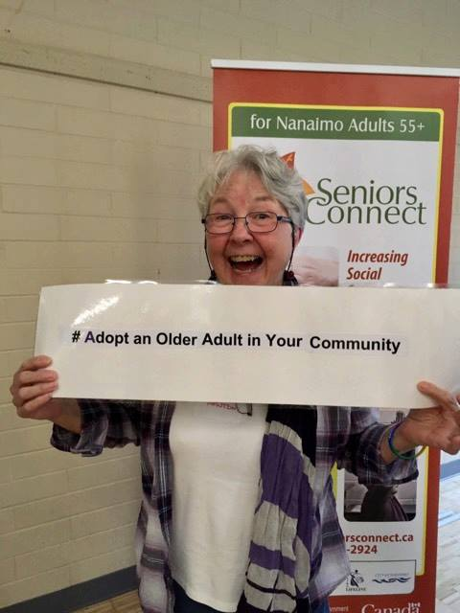
Thank You!
Any Questions?
Proudly certified - Better Together Champion!
Take Champion Training to your Community
Evaluation
Materials to take home
This project is funded by the Government of Canada's
New Horizons for Seniors Program.
Better Together: Age-Friendly Nanaimo
Notes:
Pass out the evaluations, certificates, business cards, SI brochures, Crisis Line cards.
Please help us to spread the word about the workshop!

